Slide 1





CORONA VIRUS ANALYSIS
Using SQL
By Shahanas Beegam P

Slide 2
INTRODUCTION
The CORONA VIRUS pandemic has had a significant impact on public health and has created an urgent need for data-driven insights to understand the spread of the virus. In this presentation a data related to corona virus is analyzed using SQL and certain meaningful insights are drawn.

Slide 3
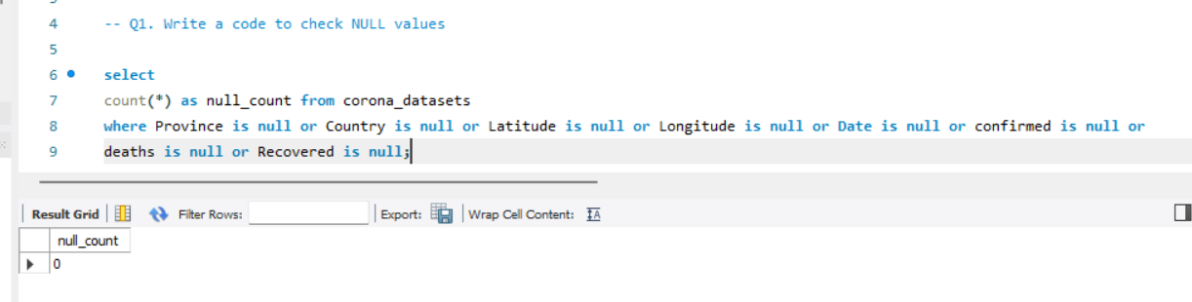
CHECKING NULL VALUES
SQL Query and Result
Note:
The result shows there is no null value in the data

Slide 4
HANDLING NULL VALUES
From previous result it is evident that there is no null value in the given data.So there is no need of updation.

Slide 5
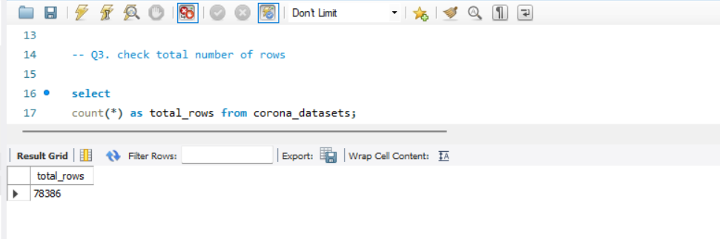
TOTAL NUMBER OF ROWS
SQL Query and Result
Note:
There are 78386 rows in the given data.

Slide 6
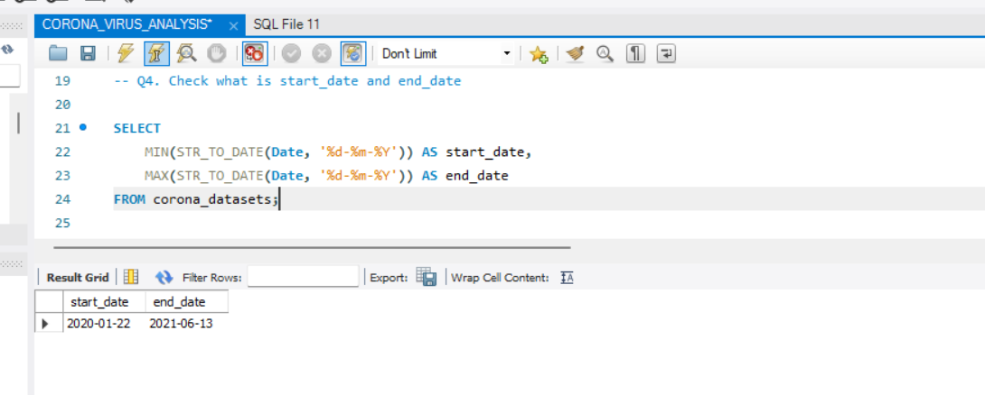
START DATE AND END DATE
SQL Query and Result
Note:
Start date of dataset:2020-01-22
End date of dataset:2021-06-13

Slide 7
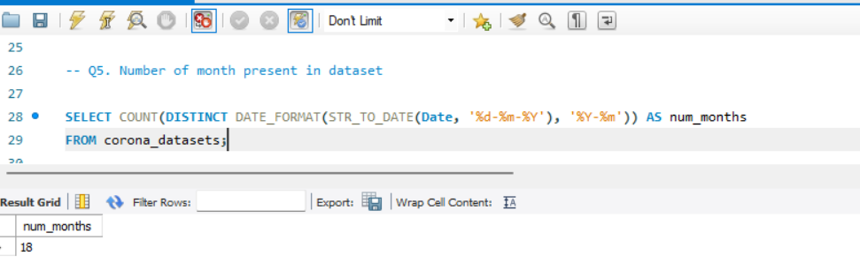
NUMBER OF MONTHS IN THE DATASET
SQL Query and Result
Note:
There are 18 months in the given dataset.

Slide 8
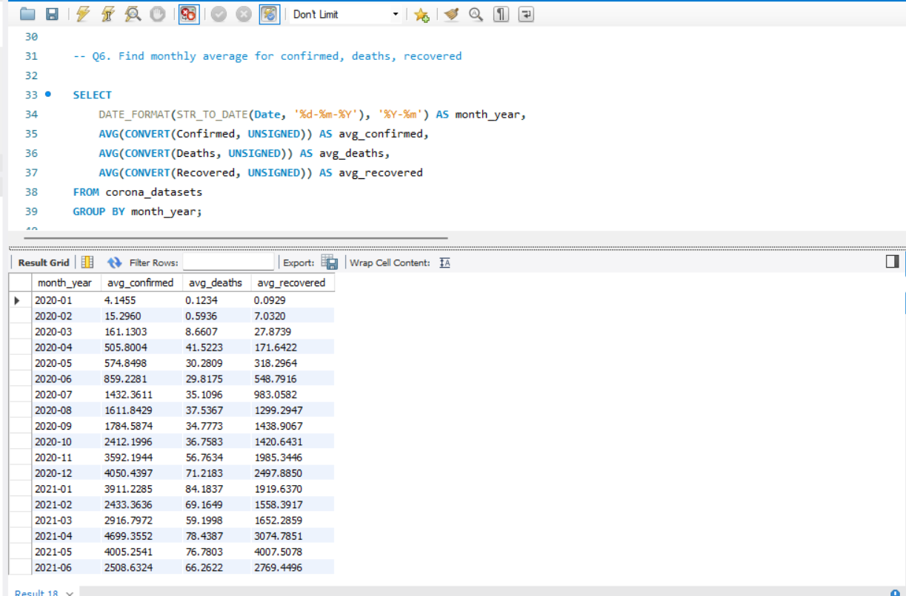
MONTHLY AVERAGE FOR CONFIRMED,DEATHS AND RECOVERED CASES
SQL Query and Result

Slide 9
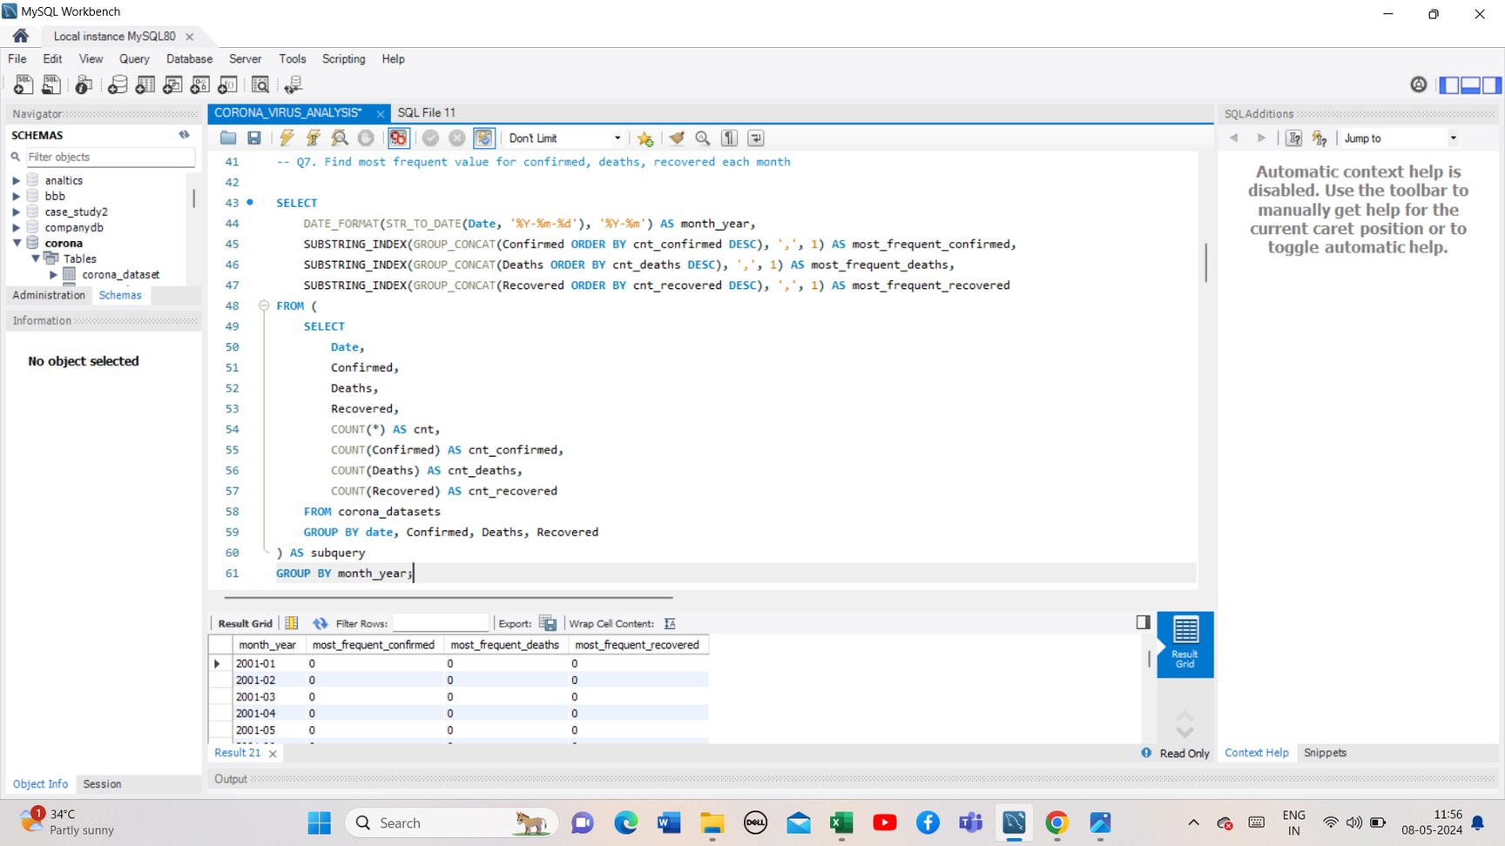
MOST FREQUENT VALUE FOR EACH MONTH
SQL Query and Result

Slide 10
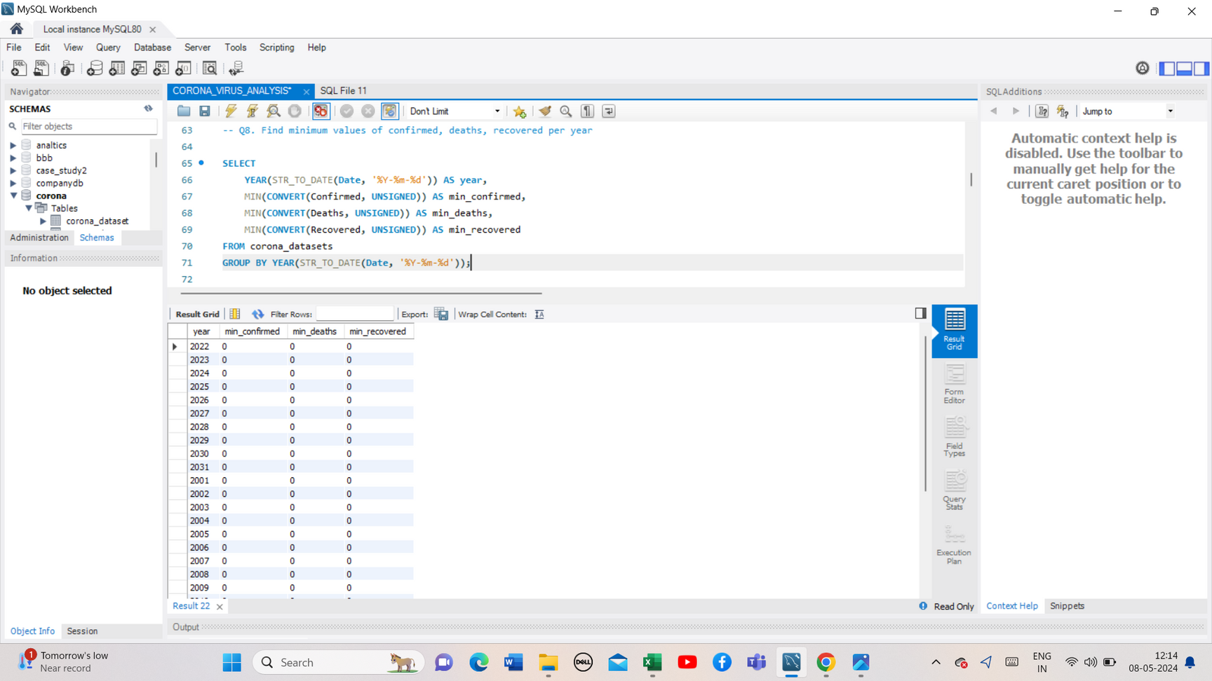
MINIMUM VALUES FOR CONFIRMED,DEATHS,RECOVERED
CASES PER YEAR
SQL Query and Result

Slide 11
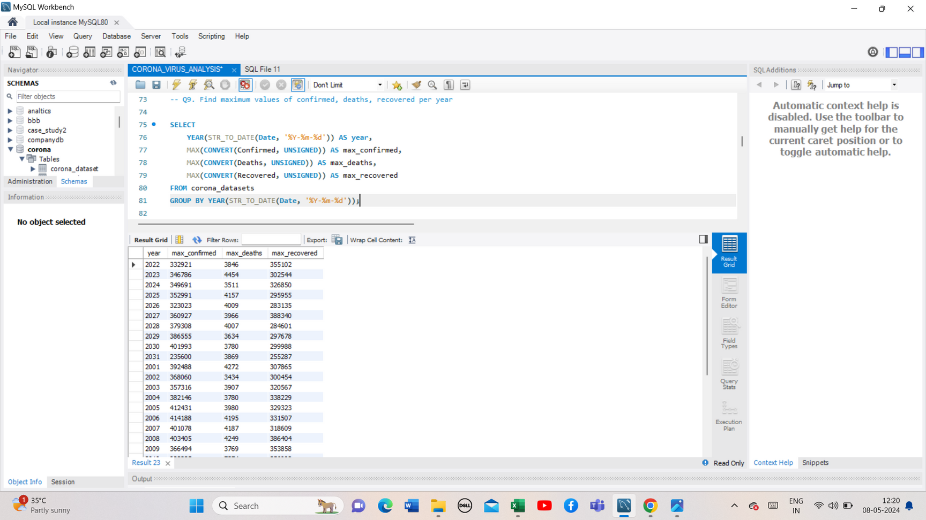
MAXIMUM VALUES FOR CONFIRMED,DEATHS,RECOVERED
CASES PER YEAR
SQL Query and Result

Slide 12

TOTAL NUMBER OF CASES EACH MONTH
SQL Query and Result

Slide 13
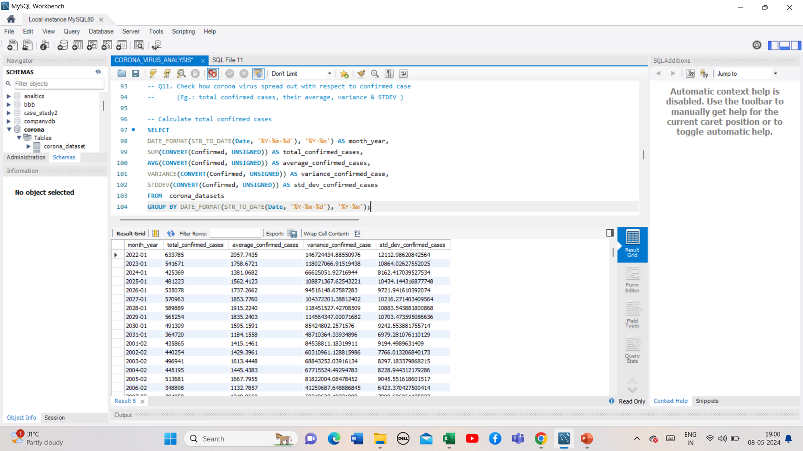
CORONA VIRUS SPREAD OUT -CONFIRMED CASES
SQL Query and Result

Slide 14
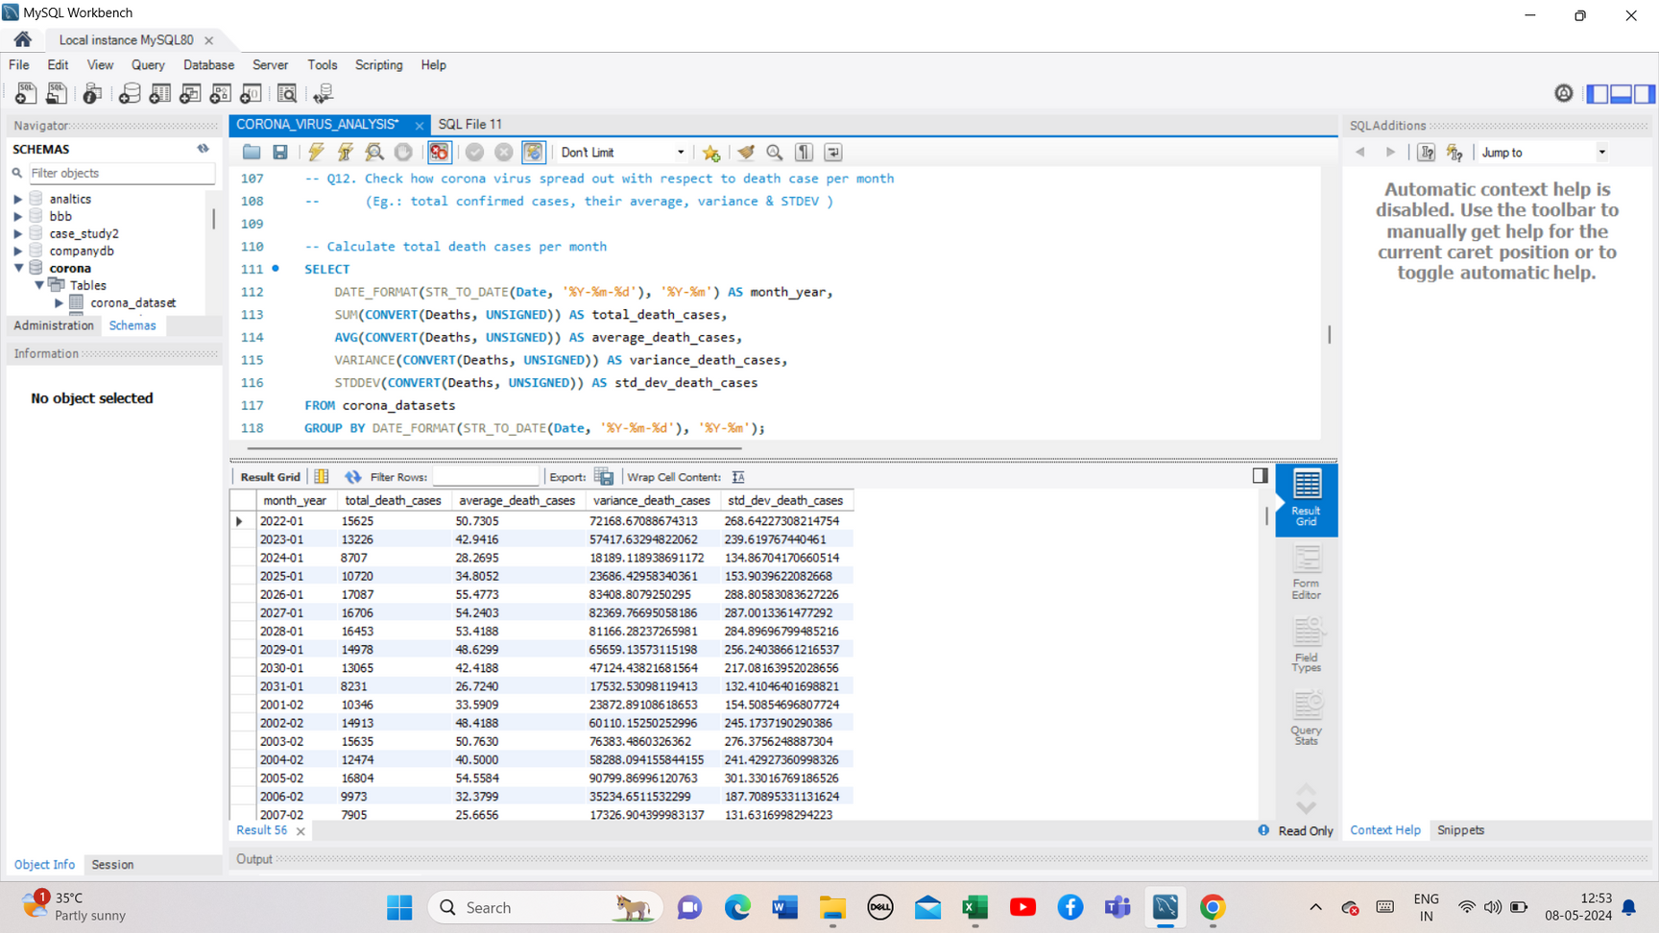
CORONA VIRUS SPREAD OUT -DEATH CASES
SQL Query and Result

Slide 15
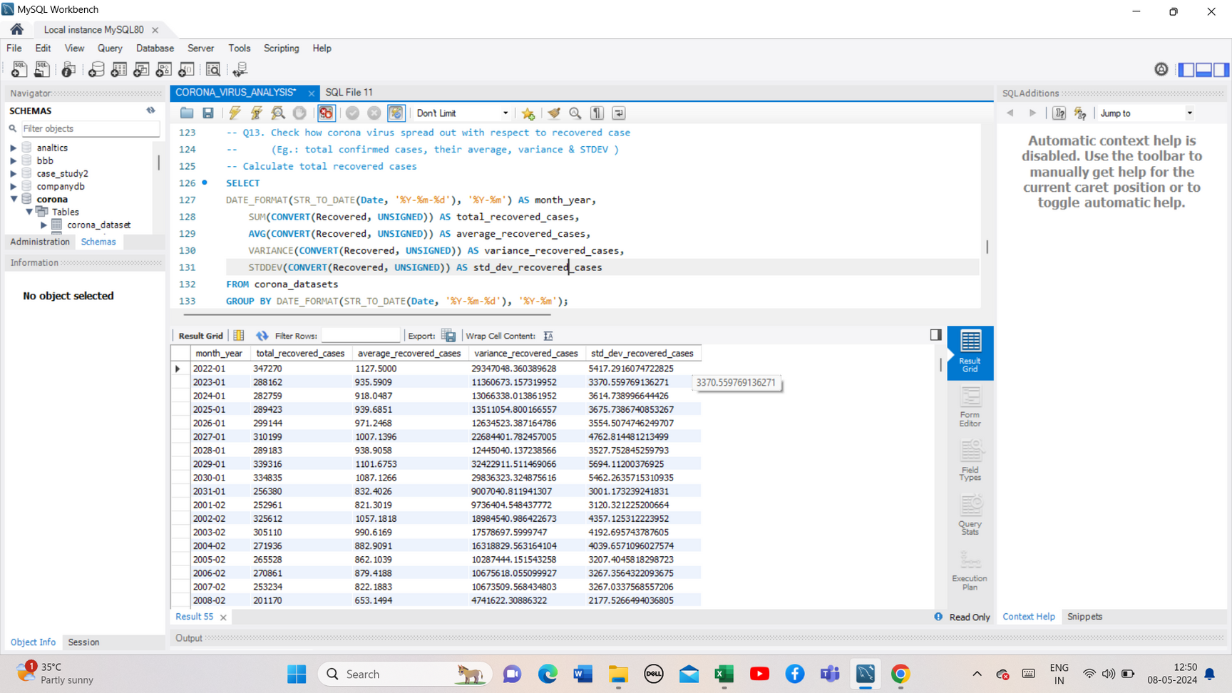
CORONA VIRUS SPREAD OUT -RECOVERED CASES
SQL Query and Result

Slide 16
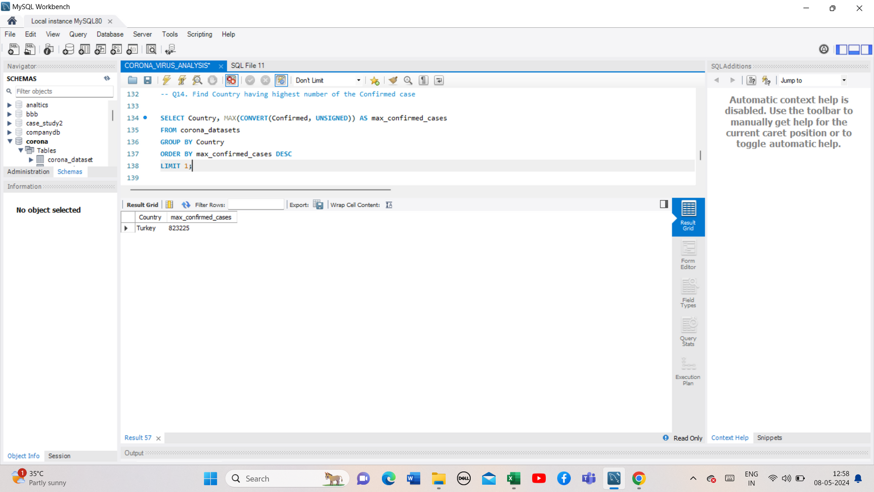
COUNTRY WITH HIGHEST CONFIRMED CASES
SQL Query and Result
Note:
Turkey has the highest confirmed cases in this dataset.

Slide 17
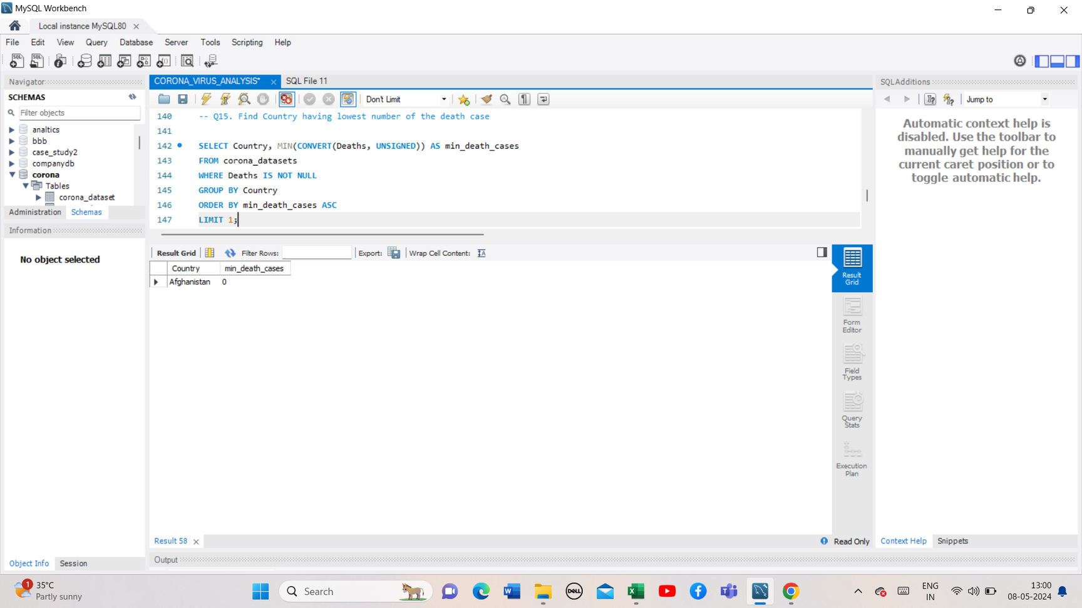
COUNTRY WITH LOWEST DEATH CASES
SQL Query and Result
Note:
Afganisthan have lowest death cases in this dataset.

Slide 18
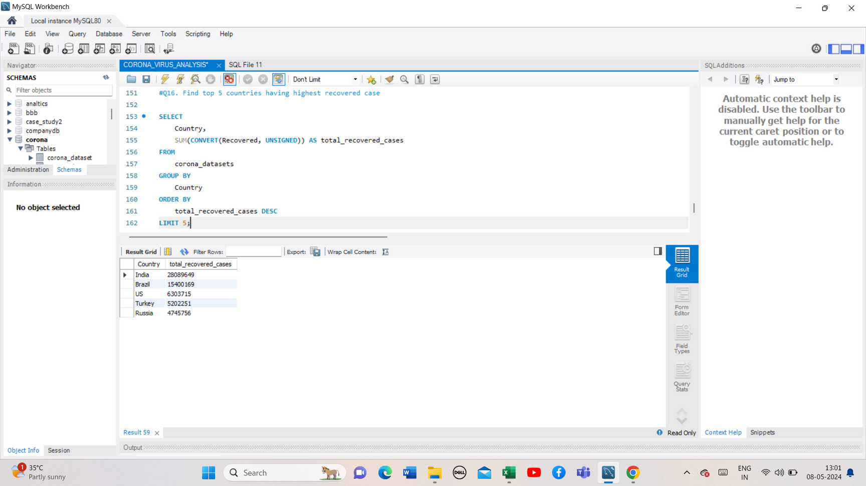
TOP 5 COUNTRIES WITH HIGHEST RECOVERED CASES
SQL Query and Result
Note:
Top 5 countries with highest recovered cases are India, Brazil, US, Turkey, Russia.

Slide 19
CONCLUSION
In conclusion, using SQL to analyze COVID-19 data has helped us understand its impact on health, economies, and societies. I have learned a lot about the challenges it poses.
As we look to the future, it's clear that SQL-driven insights are vital for making informed decisions during health crises. Working together, finding new ways to use SQL, and staying adaptable will be key to facing future challenges and keeping people safe.

Slide 20
THANK YOU

